Slide 1
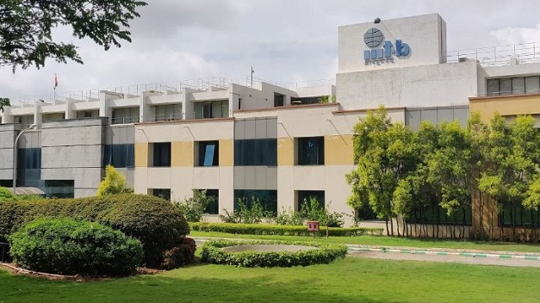

Simulation of a NS3 framework towards a 5G Complete Network Platform
SRIP – 2023
Presentation by:
Sai Raghavi . T
Sem -7,B.E ,ECE
Amrita Vishwa Vidyapeetham
Mentors:
Jyostna Bapat
Dibakar Das
Shyam

Slide 2



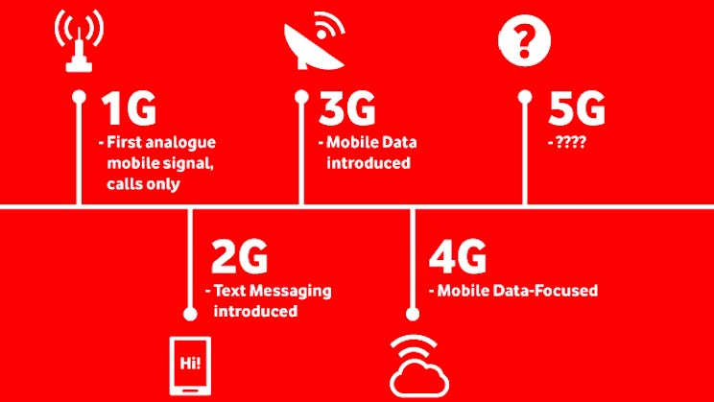


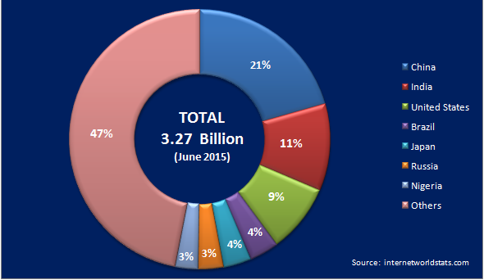
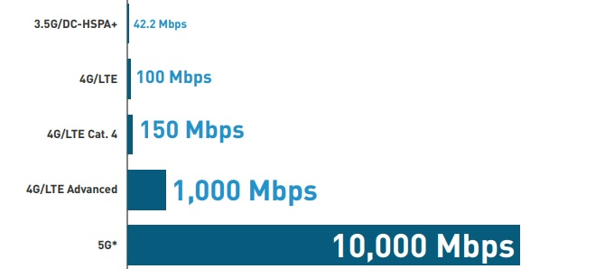

Overview
Motivation & Background
Network-Connecting the India
Evolution of Mobile Network
Source: https://www.googleimage.co/m
Global Internet Users
Limitations of Previous Networks
Source: https://www.cioandleader.com/
Demand for 5G Network
2
Source: google image

Slide 3
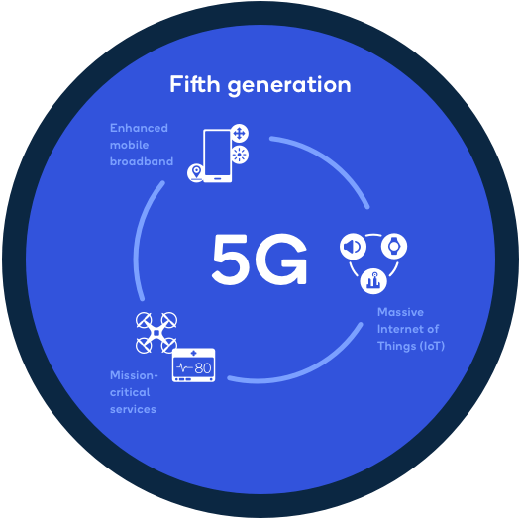
What is 5G?
Intro
5G - Revolutionizing Connectivity
Key Features
Faster Data Speeds
Low Latency
Massive Device Connectivity
Enhanced Capacity
Network Slicing
Future Applications
autonomous vehicles
smart cities
remote healthcare
immersive virtual reality (VR)
augmented reality (AR)
industrial automation
enhanced mobile services.
Source: Google Image
1

Slide 4
Objective And Approach
Rationale
Objective: Simulation of a NS3 framework towards a 5G Complete Network Platform
Rationale of the proposed concept:
Addressing the Need for a 5G Complete Network Platform
Programming code
Performing Ns3 Simulation
Analyze the simulation results
Tools Integrated :
Tools | Versions
Virtual Box | 7.0.8
Ubuntu | 22.04.2 LTS
Ns3 | 3.38
5G Lena | v2.4.y -cmake
Advancing Research and Development in 5G Networks
Leveraging the Capabilities of the NS3 Framework
4

Slide 5
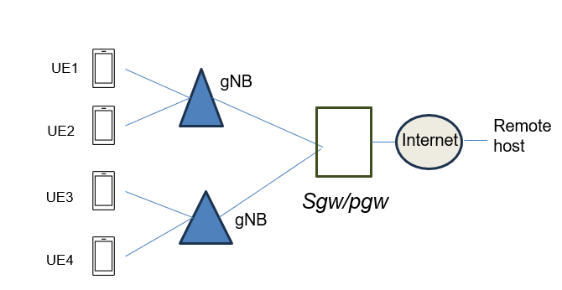
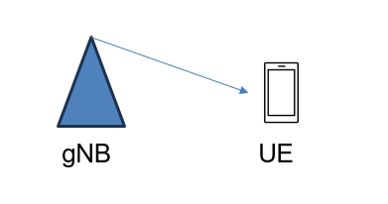
work done so far
PROGRESS
5G NR Simulation
Integrated 5G NR with 4G core
https://sharing.clickup.com/clip/p/t37257552/e0c7d75f-bbf6-4ea6-b9e2-d5983413bcf2/screen-recording-2023-06-28-11%3A41.webm
https://sharing.clickup.com/clip/p/t37257552/69f6ec56-deec-4b11-a736-de3b9e16a1e1/screen-recording-2023-06-28-11%3A45.webm
https://sharing.clickup.com/clip/p/t9002150960/e2be59e8-0a39-41a5-a457-78edd05c83dd/screen-recording-2023-07-11-16%3A17.webm

Slide 6

work done so far
PROGRESS
Integrated 5G NR with 4G core interfacing with voice call application
UE-1
Remote host
gNB
Internet
Sgw/pgw
UE -2
gNB
https://www.loom.com/share/96e9b3c28f914b1ea94a52f736899bb5?sid=82adcbc1-abcb-488d-bb31-1f4a81c91738

Slide 7
Workflow
PROGRESS
Phase-3
Phase-5
Proposing the concept
Compiling 5G NR and 5G NR End-to-End Integration with Voice Application
Phase-1
Understanding the literature survey
End of development
Installing the required software needed to this project
Integrated 5G-Lena,Compiling 5G NR and 5G NR End-to-End Integration
Collect and Analyze Simulation Results
Phase-2
Phase-4
Phase-6

Slide 8

Literature Survey
Previous Research
S. No. | Title of Project | Author & Year Published | Description | Journal | URL's
1. | Studying and Simulation of a NS3 framework towards a 5G Complete Network Platform | Francesco et al 2019 | This paper mainly focussed on simulate a complete 5G network architecture, including core, fronthaul and LTE access | IEEE Explore | https://ieeexplore.ieee.org
2. | An Improved MAC Layer for the 5G NR ns-3 module | Patriciello et al 2019 | This paper mainly focussed on advancements on on previous implementations of LTE and mm Wave modules | IEEE Explore | https://ieeexplore.ieee.org

Slide 9
Internship Takeaways
Skills
S. No. | Soft skills | Technical skills
1. | Commercial Understanding | Debugging
2. | Independent and Self-learning | Work with Computer Networks and idea about 5G Network
3. | Critical Thinking | Research skills
4. | Inclusivity | Generating the Network Topology
5. | Communication skills | Linux C++

Slide 10
Thank You!

